Slide 1

Cs project discussion
Asad Mukhtar
Zulfaqar Riaz​

Slide 2
AGENDA
Introduction
Background of the company
Primary goals / aims
Limitations
Feedback

Slide 3
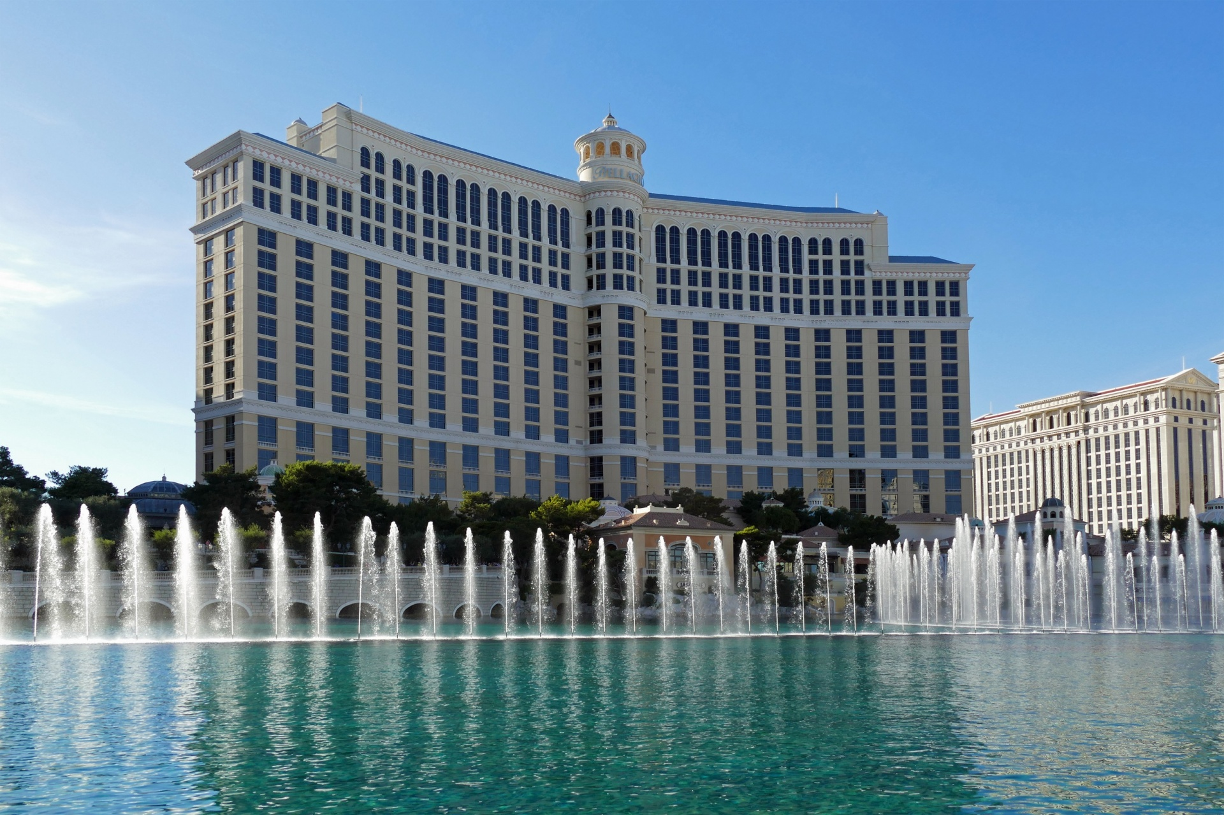
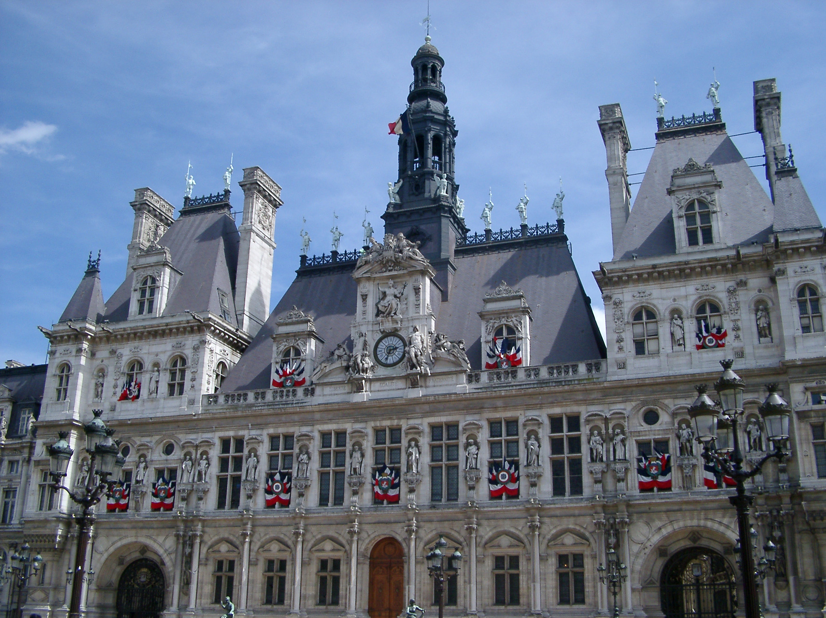
Introduction
I will be making a system for a hotel called "Raptor’s Hotel". This is because the current system at Raptors is hand-written meaning there are many problems such as illegible hand-writing and loosing track of rooms booked and even loosing records. As a result, Raptor hotel has a bad reputation around Manchester. Therefore, I will be building a system for Raptor Hotel and tackle these problems.
My project will allow the user to book a room in the hotel. The users will be able to pick the room based on bed size, number of people, appearance, cost etc.... Then they will choose the date/dates available to avoid collisions.
After customers have booked a room, customers should be able to see previous bookings
When purchasing they will be asked to enter their personal details such as their address, their email, phone number, name, etc. They will then enter payment details and will be given an order number.

Slide 4
Background of the company
The Raptor's Hotel, Located in Manchester was founded by 2 brothers, John and Eric also known as the " Raptor Brothers".
It was established back in 2020
The raptor in the logo also intensifies the nature of the hotel as raptors are known for preying and focusing on prey (in this case customers). This is reinforced by the slogan "Stay in the heart of Manchester" as it further emphasizes the care for customer wellbeing of living in the heart of the city (Manchester).
The hotel is suffering from a lack of demand and the reason is that the system Raptor Hotel currently uses is outdated. This is probably because they still use a paper-based system. Therefore I will be helping them build a better system.

Slide 5
Stakeholders
Stakeholders are anyone interested in the project.
The following people are the stakeholders and why they may be interested in the project.
The owner- The owner is the person who is looking for the changes in the system. This is because the current system is not working effectively. As a result, creating a new system. Therefore, being my stakeholder and potential shareholder.
Staff members- Staff members are working harder than they should be with the current system as they require checking in, checking out, storing all the data somewhere safe, etc.… By using computers, they can minimize errors such as bad handwriting or loosing data. Therefore, being a stakeholder.
Customers- Customers realize that the current booking system is not ideal, as there are no pictures of current rooms, booking takes too long and may like to see nearby locations to enhance their experience. Therefore, being a stakeholder.

Slide 6
PRIMARY GOALS
With this project I intend to:
Create a system that will allow users to book a room, on days that this specific room is available.
I will also implement features such as a log-in system for both customers and staff separately, to keep the user's information private and secure.
I will also attempt to avoid clashes, meaning if one person books a room other people can't book that same room as it is been used by someone else.
Provide information about the different rooms they can book/select, for example; number of beds, balcony or even number of windows.
Personal goals, to gain a good coding experience.

Slide 7
Limitations
One limitation that will hold back me is my visual basic skills. This is because I may not be aware of certain functions and extensions within visual basic
Another limitation that I will face would be that I'm not developing a website. This is because this is a school project and not an actual project that will be available for anyone to use
Furthermore , I will not be developing an app, as this is an A level project so I will not have enough time to develop an app for the hotel.
Lastly, One consumer can make a reservation at a time, which is the final restriction I will encounter.

Slide 8
feedback

